Slide 1


Advanced Customization
Esri Developer Summit
March 8–11, 2016 | Palm Springs, CA
Wolf Kaiser

Slide 2
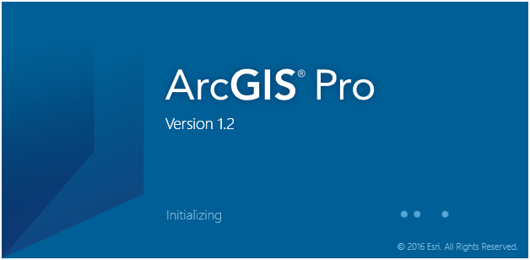
Advanced Customization for the Pro SDK
Splash Screen
DAML Filters
Customization Filters
Drag & Drop

Slide 3
Splash Screen
Create an Assembly
Add your Splash Screen image as a Resource to that Assembly
Create a file called ArcGISPro.Config.xml. Save to the ArcGISPro.exe bin folder
Add an XML Element “<SplashScreen />
The SplashScreen element must contain:
The path of the Assembly containing the splash screen image
The pack URI of the splash screen image resource
Notes:
C:\Program Files\ArcGIS\Pro\bin

Slide 4
Splash Screen
ArcGISPro.Config.xml
<?xml version="1.0" encoding="utf-8" ?>
<ArcGIS.Custom
xmlns="http://schemas.esri.com/ArcGIS/Custom"
xmlns:xsi="http://www.w3.org/2001/XMLSchema-instance"
appName="Custom SplashScreen Example">
<!-- Change the assembly path attribute to point to the location of
your SplashScreen.dll file-->
<SplashScreen assembly="C:\Data\SplashScreen\bin\Debug\SplashScreen.dll" image="Images/CustomSplash.png"/>
</ArcGIS.Custom>
Notes:
The dll and image can be called anything

Slide 5
DAML Filter
Recap: Pro UI is declarative.
Add DAML that can be applied “in addition to” DAML that may or may not be in any loaded Add-ins.
DAML does NOT need to be associated with any Add-in. Can be a stand-alone xml file
Also uses the ArcGISPro.Cofig.xml
Add a <DAML /> xml element
Contains the path to the DAML xml file
Notes:
May have dependencies on dlls under C:\Program Files\ArcGIS\Pro\bin\Extension

Slide 6
DAML Filter
ArcGISPro.Config.xml
<?xml version="1.0" encoding="utf-8" ?>
<ArcGIS.Custom
xmlns="http://schemas.esri.com/ArcGIS/Custom"
xmlns:xsi="http://www.w3.org/2001/XMLSchema-instance"
appName="Custom SplashScreen Example">
<!-- Change the path attribute to point to the location of
your Daml filter file-->
<DAML path="C:\Data\DamlFilter\CustomDamlFilter.daml" />
</ArcGIS.Custom>
Notes:
The daml file can be called anything and does not have to be associated with an assembly or Add-in.
So, customize ribbon interface with no modules or code-behind.

Slide 7
Customization Filter
Can be added to any Add-in
Is called every time any command on the Pro UI is (to be) executed.
CustomizationFilter returns true to allow the command to execute and returns false to prevent the command from executing
Note: ‘SaveAs’: The current project will be closed and the ‘Saved As’ project opened

Slide 8
Customization Filter
Must derive from Contracts.CustomizationFilter
Must register as a customization filter with Pro
FrameworkApplication.RegisterCustomizationFilter(this)
Must override the OnCommandToExecute(string ID) method.
internal class CommandFilterDemo : CustomizationFilter {
public CommandFilterDemo() {
FrameworkApplication.RegisterCustomizationFilter(this);
}
/// <summary>OnCommandExecute is called every time a command is clicked on the UI.</summary>
protected override bool OnCommandToExecute(string ID) {
//TODO - implement filter
return true; //return false to prevent command from executing
}
}
CommandFilterDemo _cmdFilter = new CommandFilterDemo();

Slide 9
Drag & Drop
Drag & Drop support for:
Panes & Dockpanes
Implement a handler for drag & drop over the whole window
Implement a handler for a specific control within the pane
Pro
Implement your own handler

Slide 10
Drag & Drop for Dockpane & Pane
2 steps for Dockpane & Pane
Set ‘isDropTarget’ attribute in config.daml to ‘true’
Override virtual functions: OnDrop and OnDragOver

Slide 11
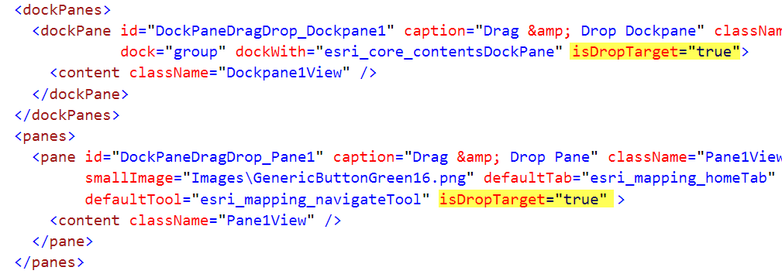
Drag & Drop for Dockpane & Pane
Set ‘isDropTarget’ attribute in config.daml to ‘true

Slide 12
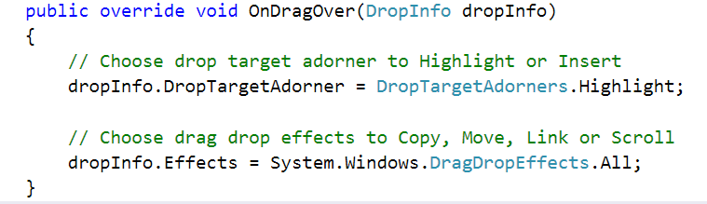
Drag & Drop for Dockpane & Pane
Override virtual function: OnDragOver
Set DropTargetAdorner and Effect according to your needs:

Slide 13
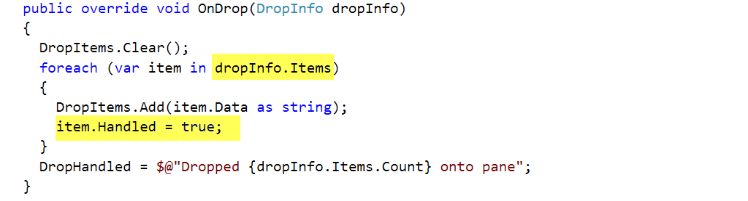
Drag & Drop for Dockpane & Pane
Override virtual functions: OnDrop
Set Item’s handled property to ‘true’ is you are processing the dropped item:

Slide 14
Demo Drag & Drop Dockpane

Slide 15
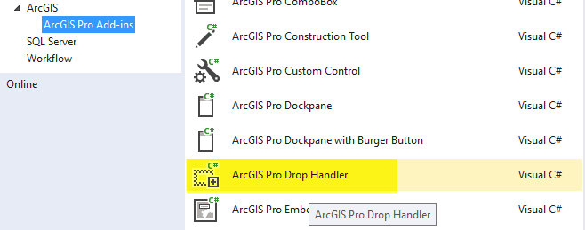
Drag & Drop for Pro
2 Steps to Implement a drop handler for ArcGIS Pro:
Insert a drop handler into config.daml
Implement drop handler derived from DropHandlerBase
Or use the item template provided by the SDK

Slide 16
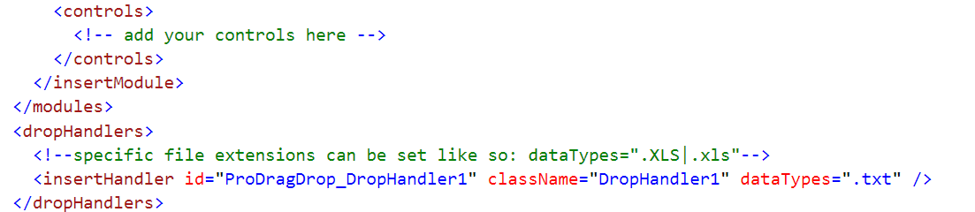
Drag & Drop for Pro
Insert a drop handler into config.daml
dropHandler tag follows the module tag
Specify file extensions in dataTypes tag

Slide 17
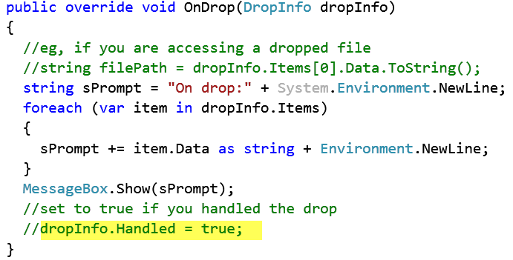
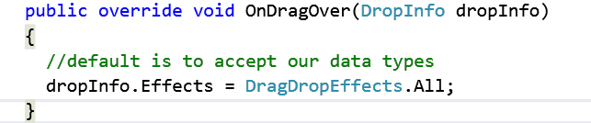
Drag & Drop for Pro
Implement DropHander derived from DropHandlerBase:
Override virtual functions: OnDrop and OnDragOver
Set dropInfo.Handled = true

Slide 18
Demo Drag & Drop ArcGIS Pro

Slide 19




